Slide 1
project review-2 ONLINE TICKET BOOKING SYSTEM
NAME :NALLA PERUMAL.A
REG.NO : 20UCA511
CLASS : III BCA
INTERNAL GUIDE : DR.S.CHIDAMABARANATHAN M.SC,MCA,M.PHIL,PH.D

Slide 2
ABSTRACT
1. The Online Ticket Booking System is a web-based application that enables users to book transport tickets online.
2. The system is designed to provide a convenient and efficient way of booking transport tickets for various modes of transportation such as buses, trains, and airplanes
3.The system allows users to create an account and login to access the booking system. Once logged in, users can search for available transport options, select their preferred mode of transportation, and book tickets.
In this there a three modules:
1. Admin
2.Employee
3.User

Slide 3
INTRODUCTION
An online ticket booking system is a digital platform that allows passengers to purchase tickets for various modes of transportation such as buses, trains, and flights, among others.
It provides an easy and convenient way for customers to book and pay for their tickets, while allowing transport companies to manage and track their bookings in real-time.With the rise of e-commerce and online services, online ticket booking has become increasingly popular among travelers.
It saves time and effort, as customers can book their tickets from anywhere and at any time, without having to physically go to a ticket counter. Moreover, it also provides access to a wide range of options, such as different routes, timings, and fares, which can be compared and selected easily.

Slide 4
Existing system:
Time-consuming
Higher prices
3. Limited information

Slide 5
Proposed system
1.Time Saving
2.Reduced costs
3.Payment Flexibility
4. Customer data management.

Slide 6
PROBLEM Definition and project description
The transportation industry is one of the largest industries in the world, with millions of people using various modes of transportation every day. However, booking transportation can be a time-consuming and often frustrating experience. Customers often have to call or visit multiple service providers to find available transport options and to book their travel. This can lead to a lot of confusion and inconvenience.
To solve this problem, we propose an online transport booking system that allows customers to book their travel online. This system will streamline the booking process and make it easy and convenient for customers to find and book the transportation they need.
Admin
User
Employee

Slide 7
Admin:
Manage transportation options, including adding new vehicles .
View and manage customer bookings
View reports on bookings and revenue
Manage the system's settings and configurations
Employee:
Add and manage the train.
Add and manage passenger
Ticket View and manage

Slide 8
User:
Search for available transportation options based on their destination and date of travel
View details of available transportation options, such as the type of vehicle, departure and arrival times, and fare
Book their travel online and pay for their booking
Cancel or modify their booking if necessary
View their booking history

Slide 9
SOFTWARE REQUIREMENTS
HARDWARE REQUIREMENTS
Processor : Intel
Ram : 4.00 GB (3.89 GB usable)
Hard disk : 40 GB
Monitor : 15’’m VGA monitor
Keyboard : 104 keys Keyboard
Mouse : Optical mouse

Slide 10
SOFTWARE REQUIREMENTS
Operating System : 64-bit OS
Local Host Server : Xampp server
Database Connectivity : PhpMyAdmin
Front End : Html and PHP
Back End : MYSQL

Slide 11
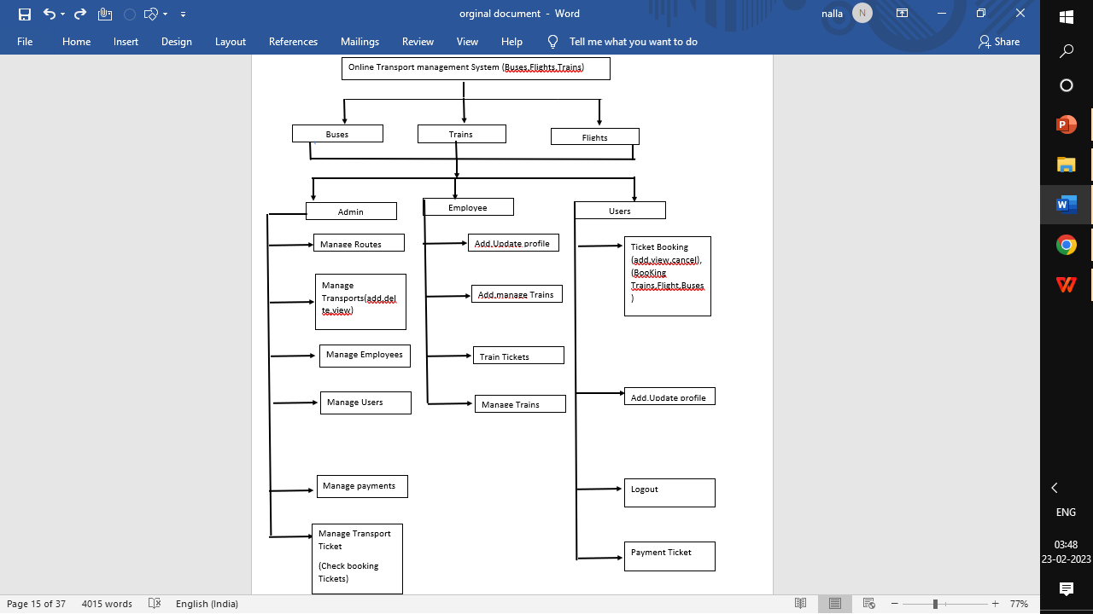
SYSTEM DESIGN
Architectural Design

Slide 12
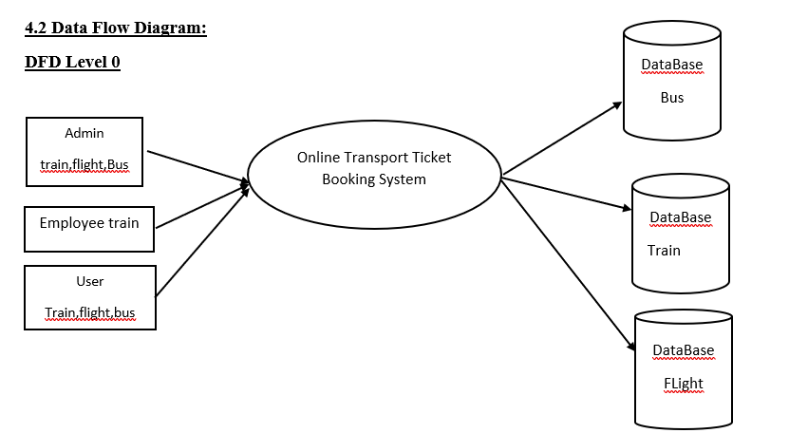
Data Flow Diagram:
DFD Level 0

Slide 13
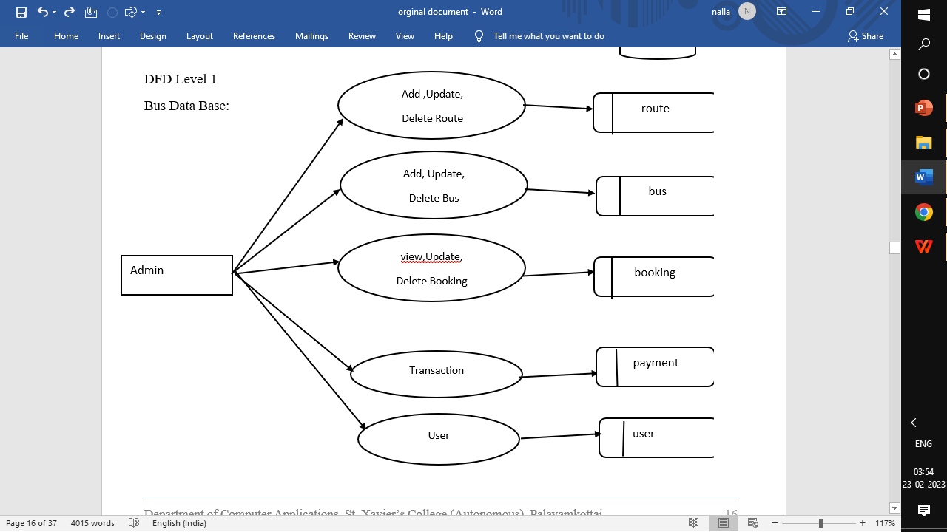

Slide 14
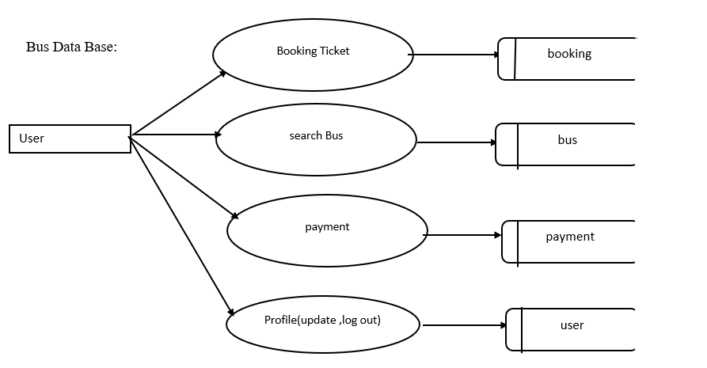

Slide 15
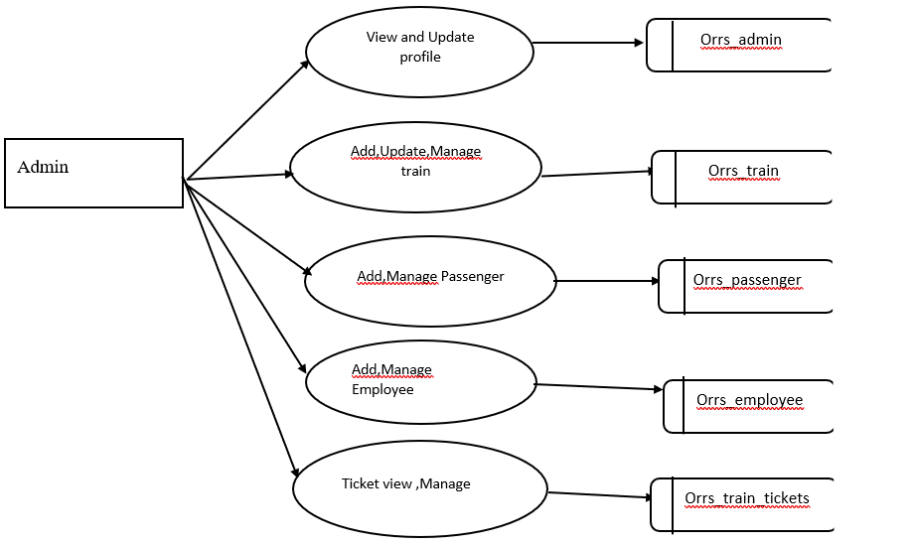

Slide 16
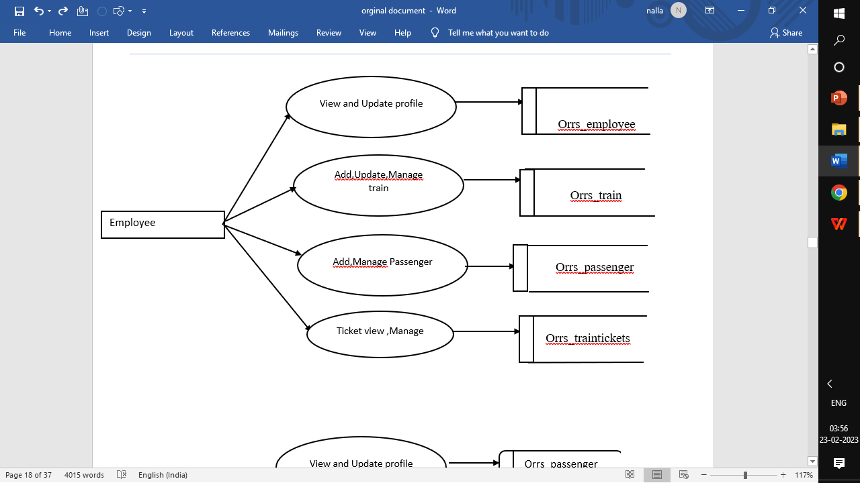

Slide 17
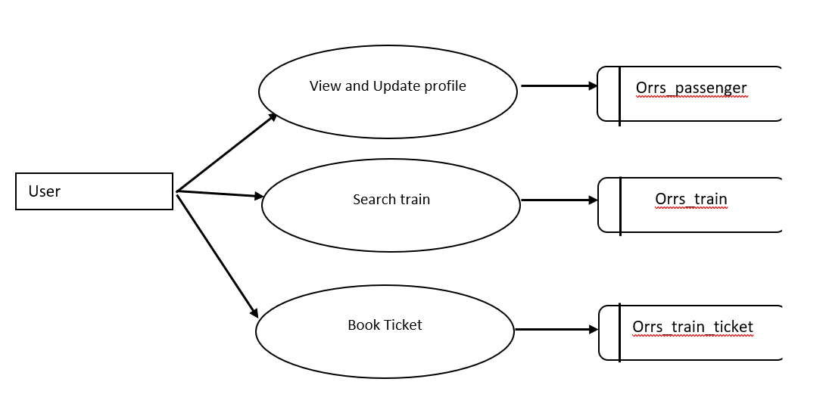

Slide 18
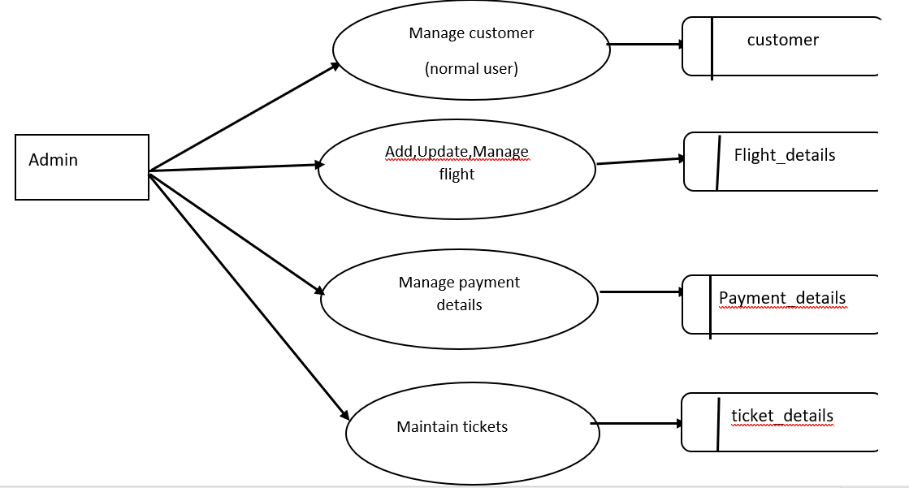

Slide 19
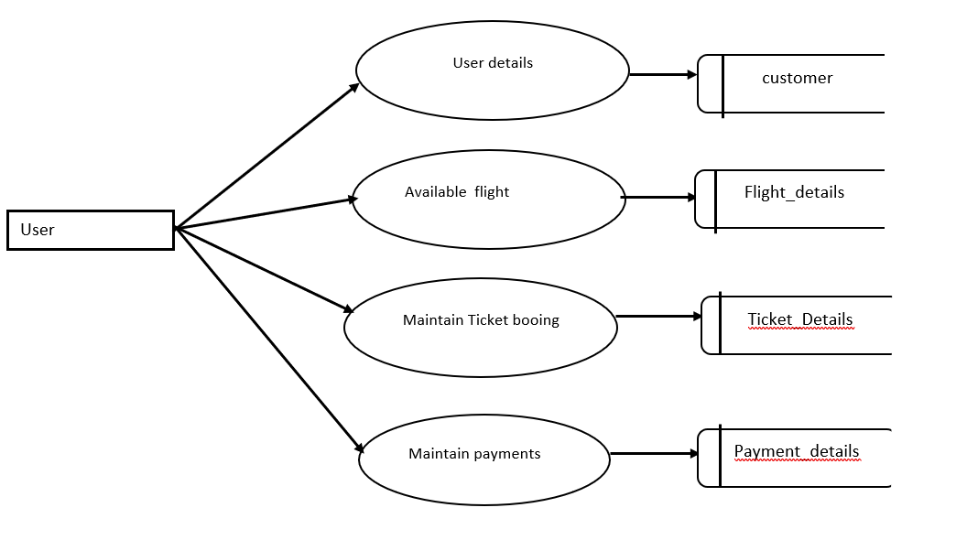

Slide 20
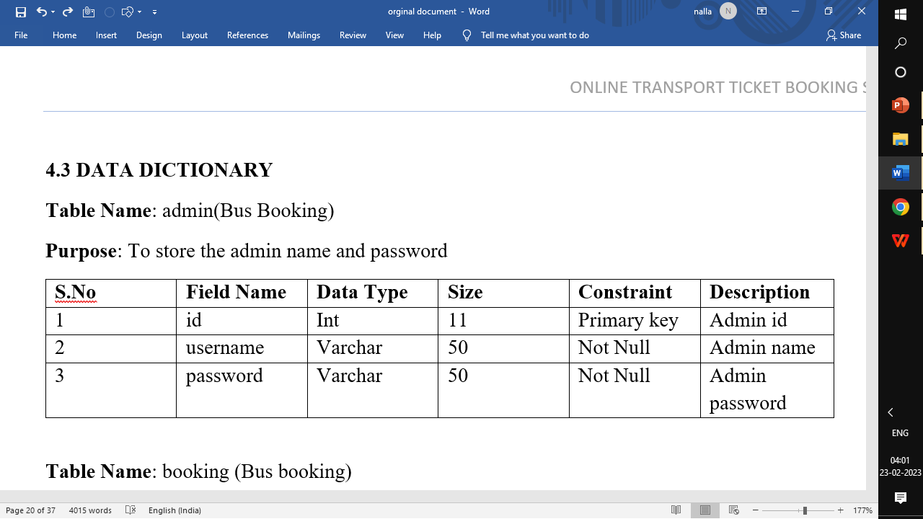
DATA DICTIONARY

Slide 21
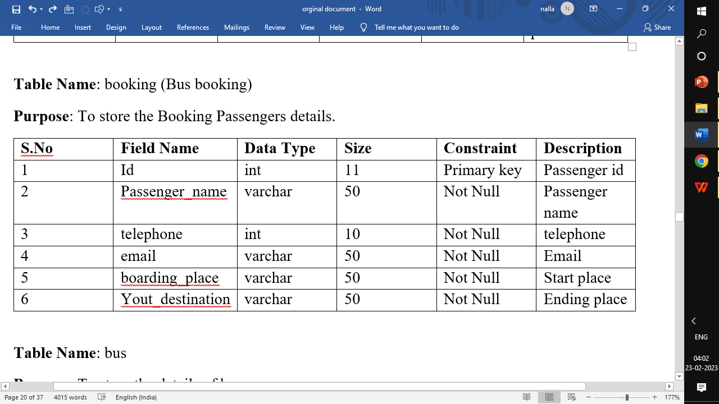

Slide 22
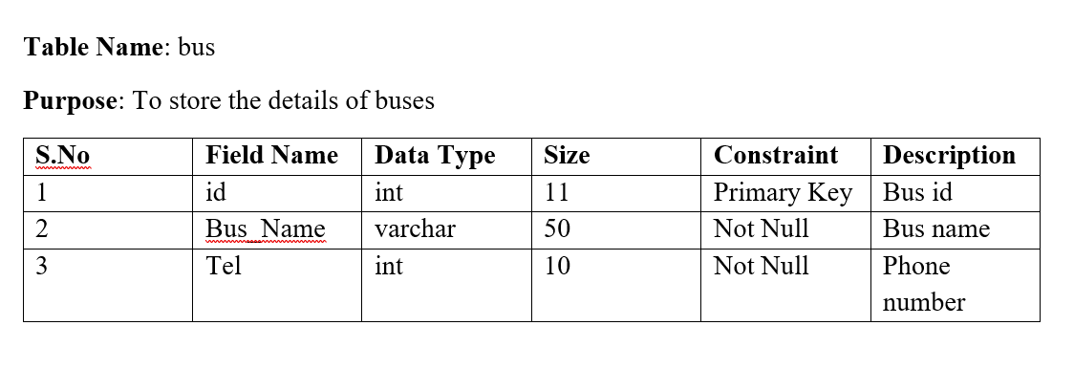

Slide 23
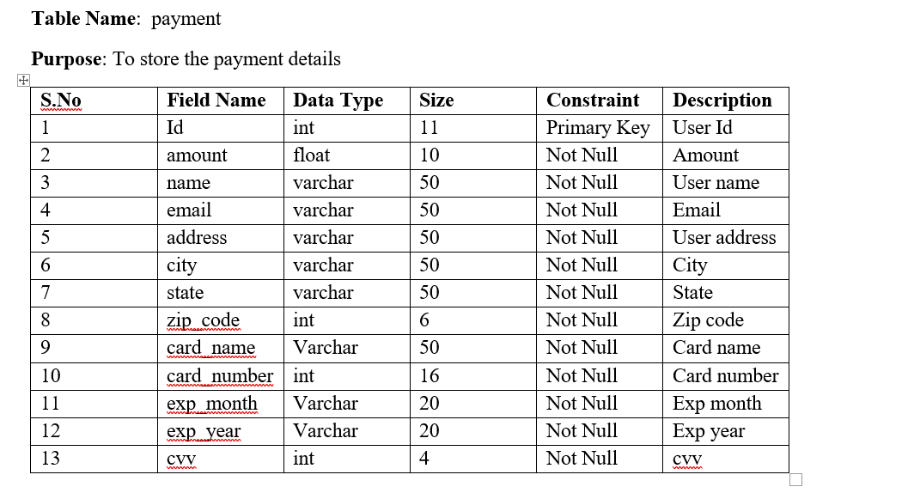

Slide 24
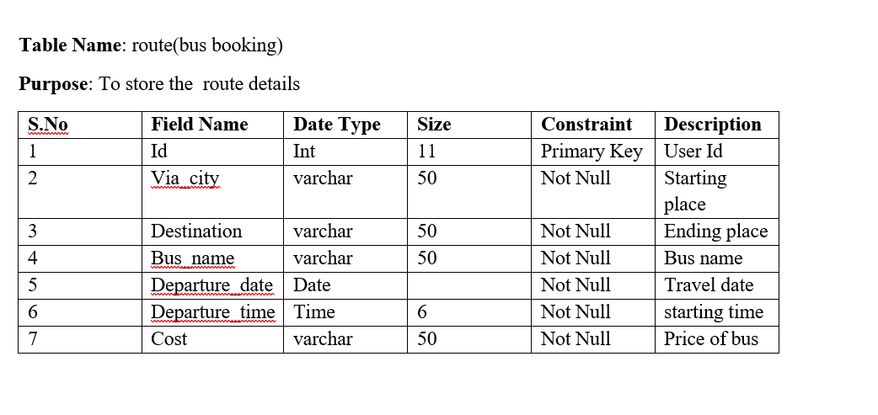

Slide 25
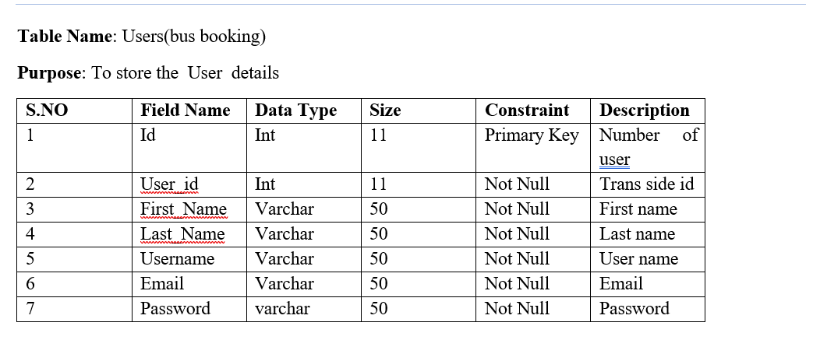

Slide 26
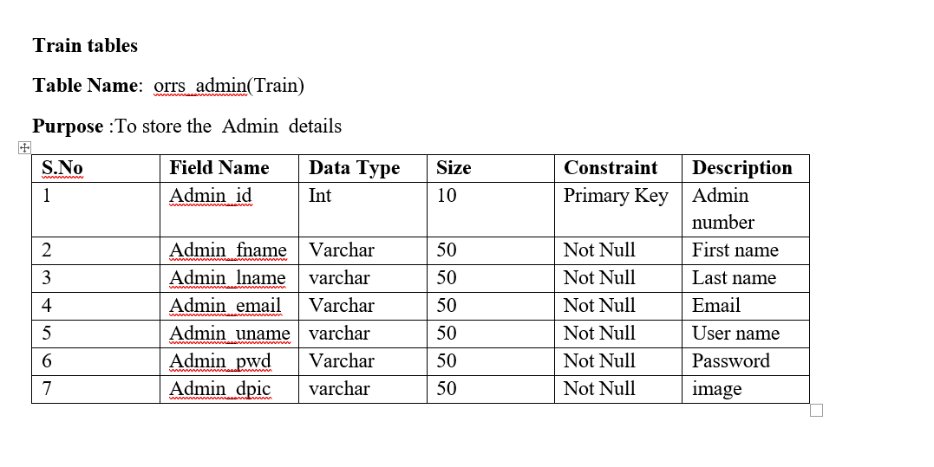

Slide 27
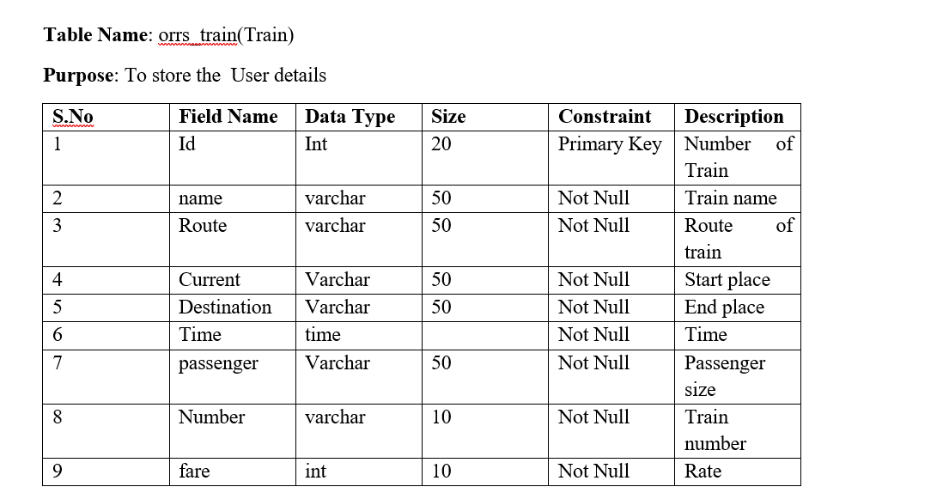

Slide 28
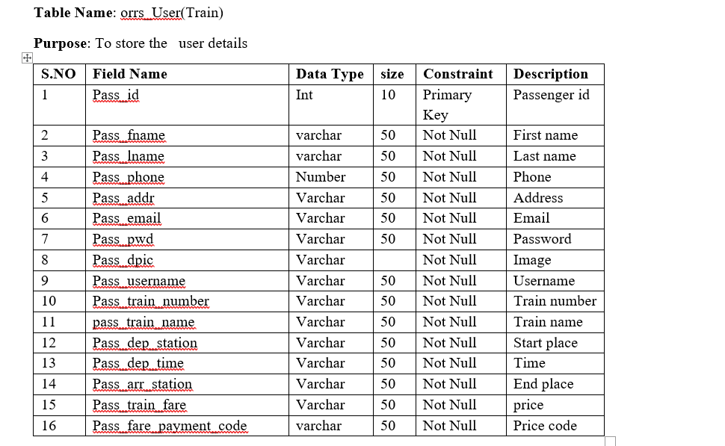

Slide 29
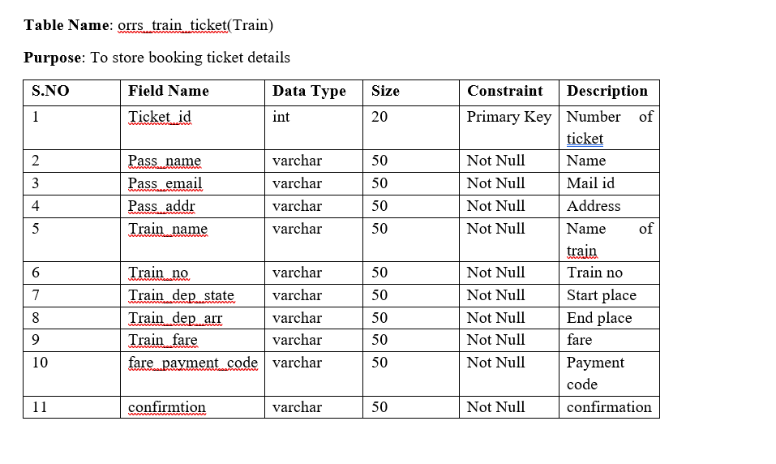

Slide 30
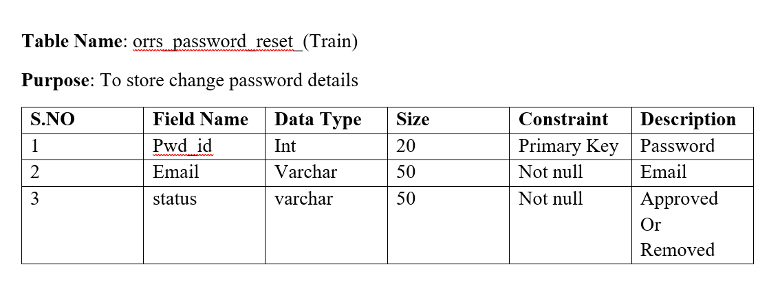

Slide 31
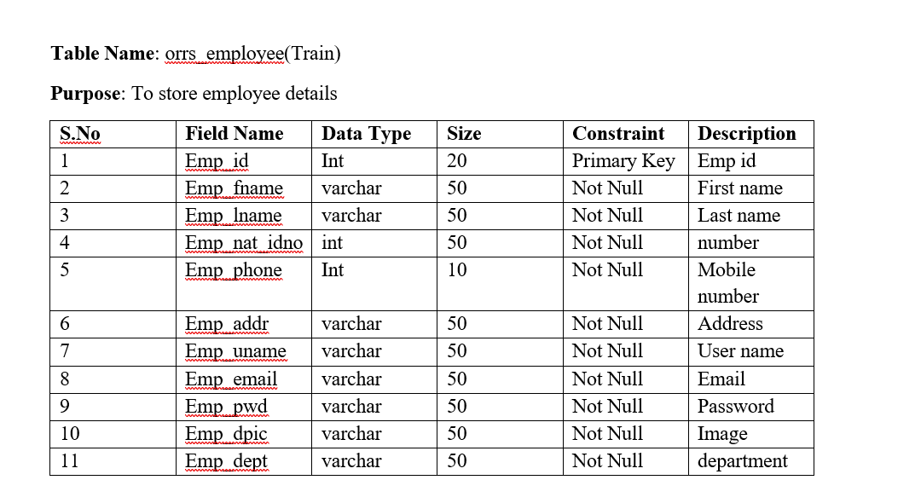

Slide 32
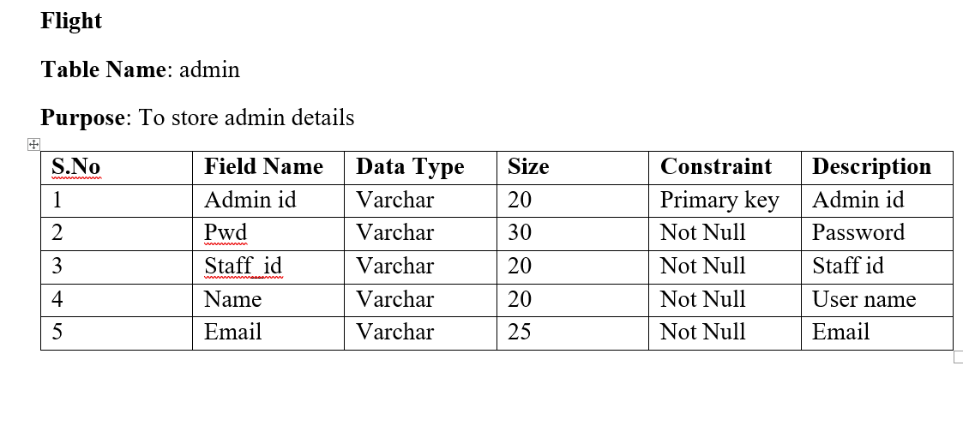

Slide 33
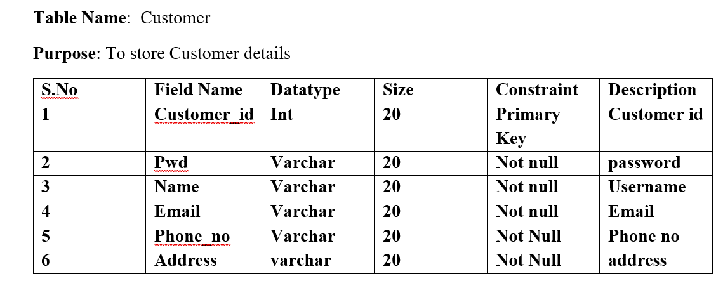

Slide 34
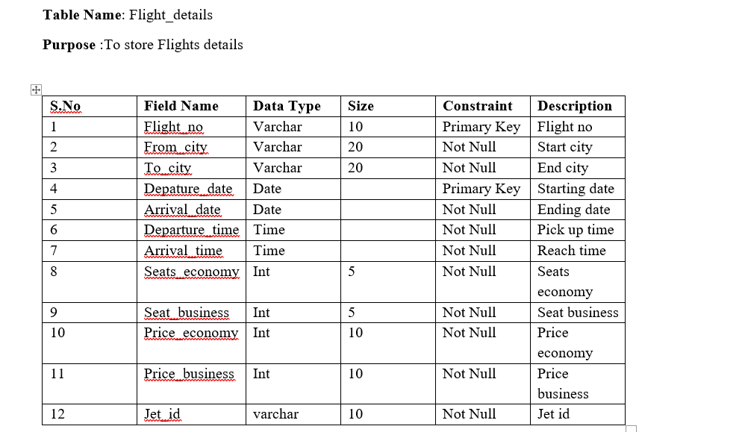

Slide 35
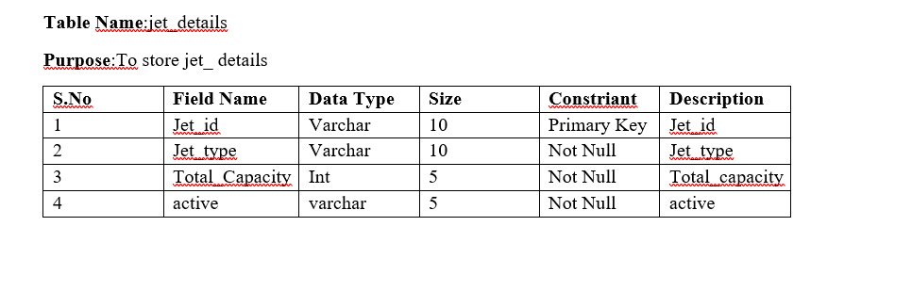

Slide 36
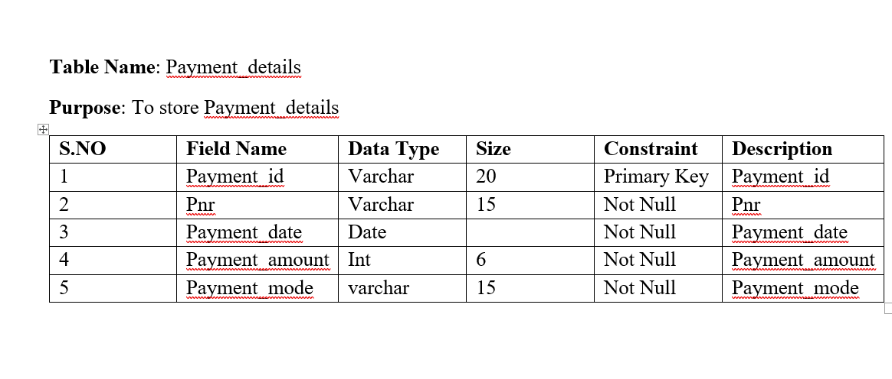

Slide 37
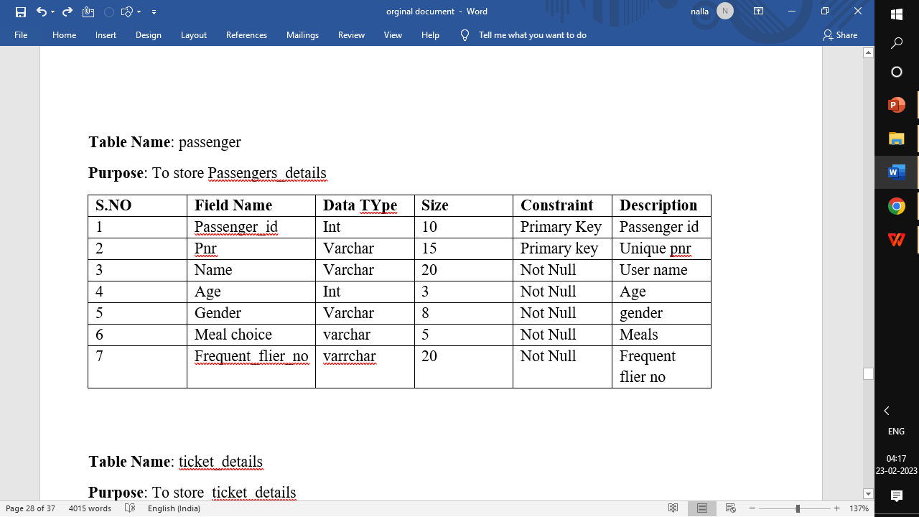

Slide 38
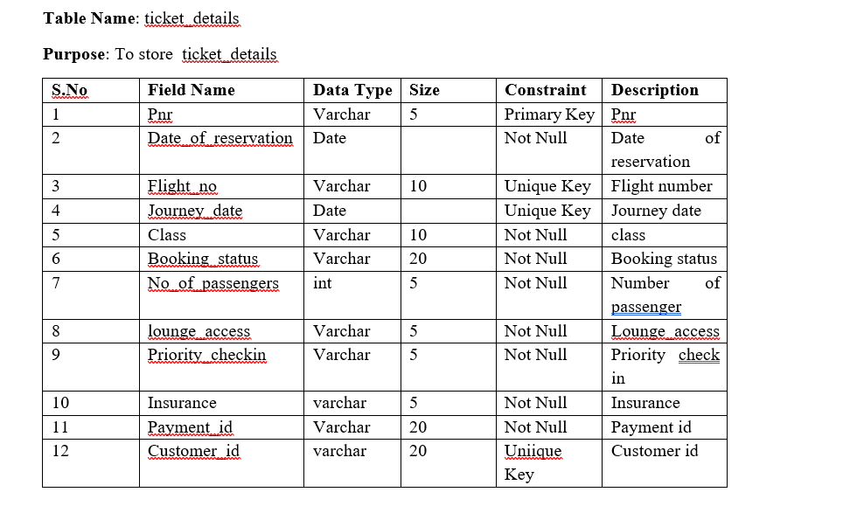

Slide 39
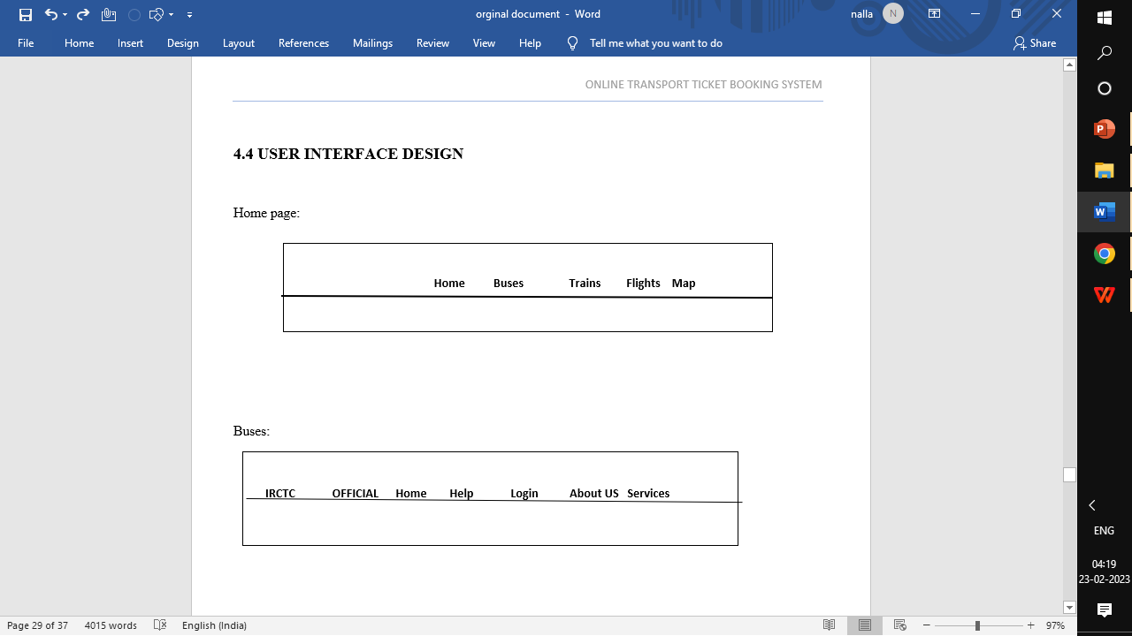

Slide 40
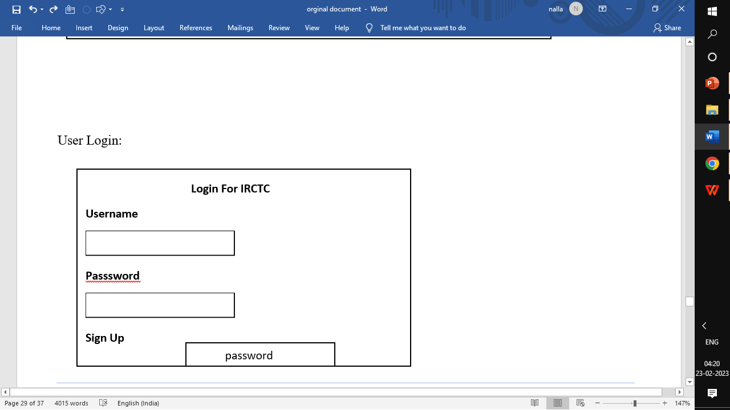

Slide 41
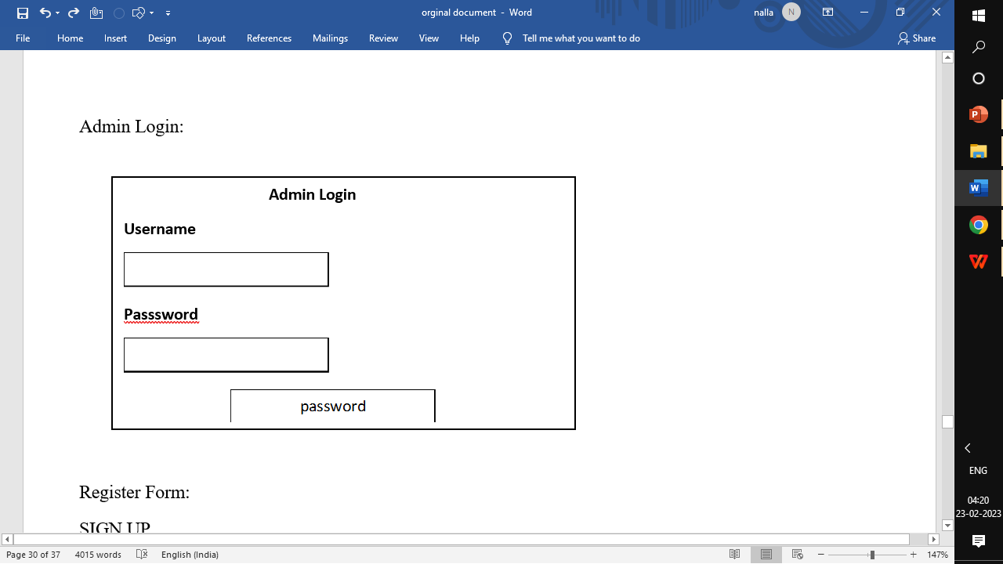

Slide 42
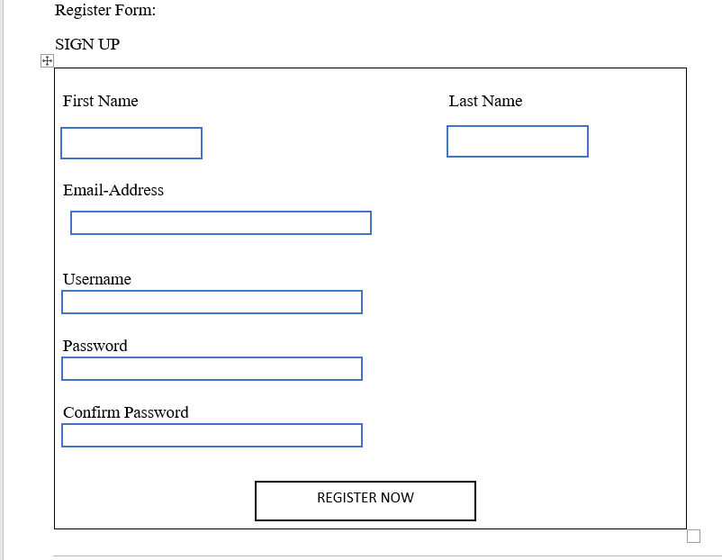

Slide 43
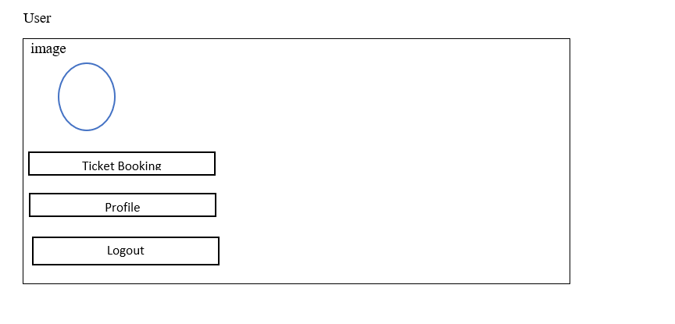

Slide 44
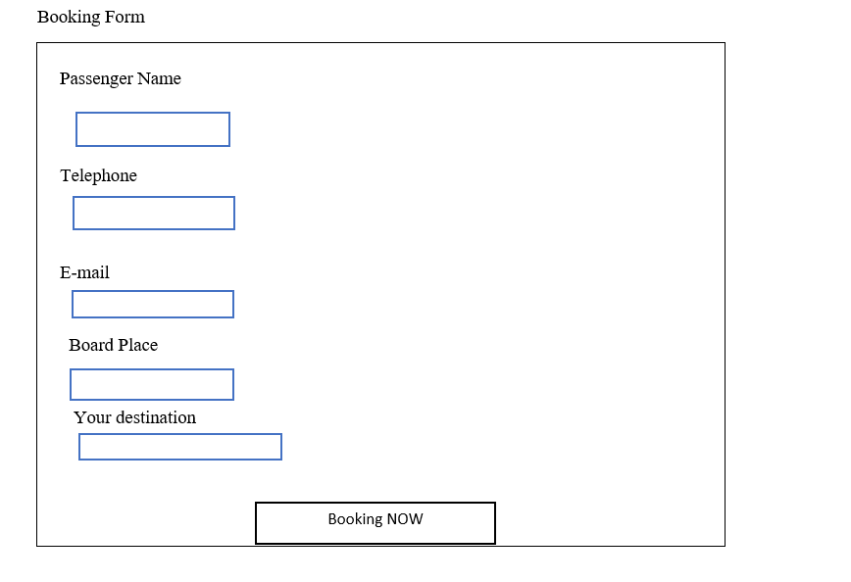

Slide 45
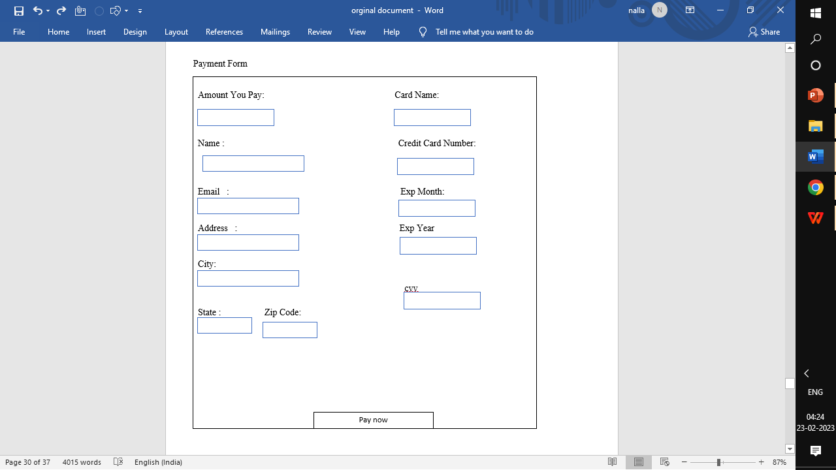

Slide 46
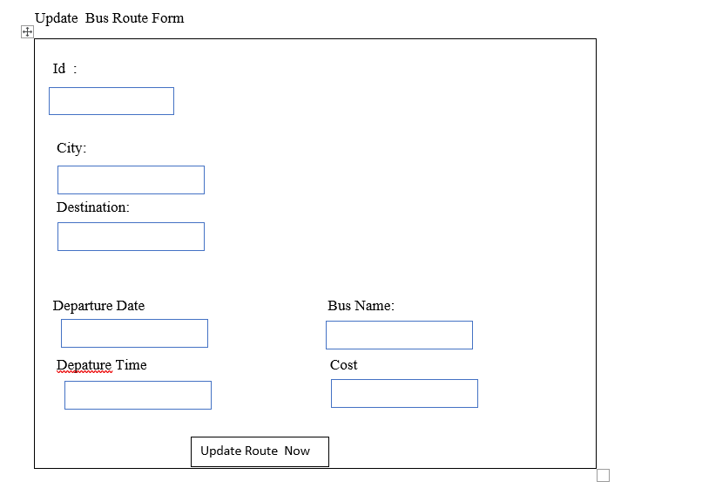

Slide 47
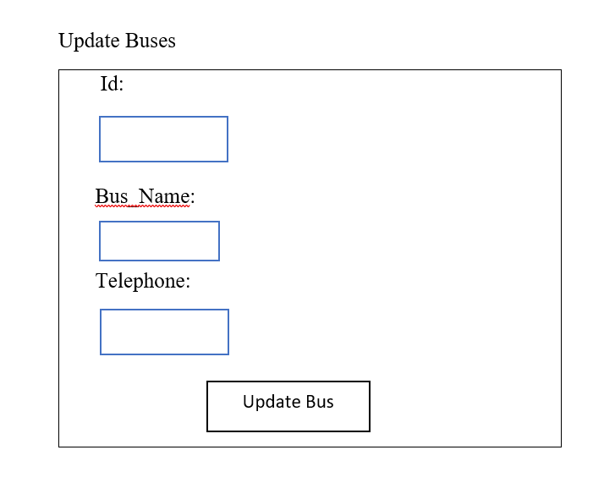

Slide 48
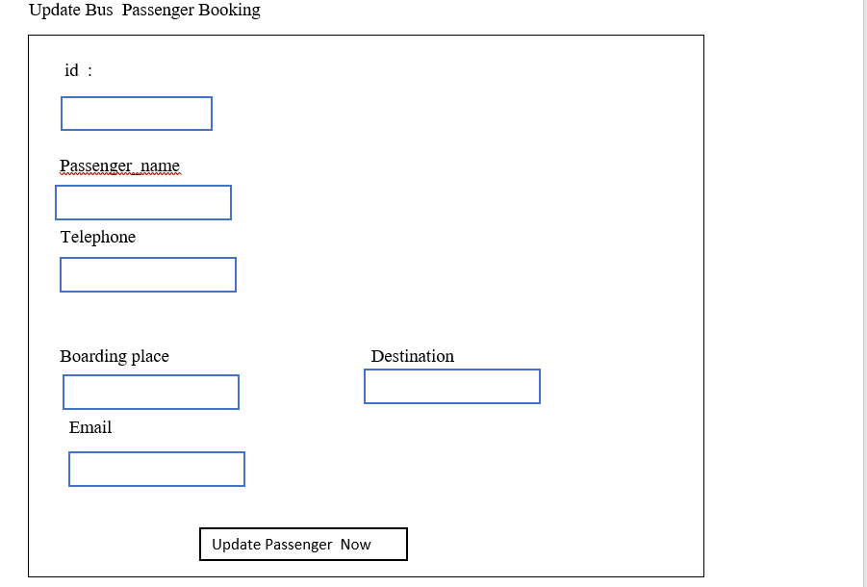

Slide 49
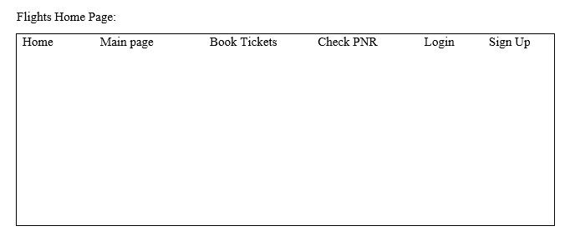

Slide 50
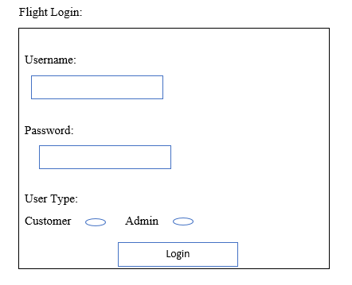

Slide 51
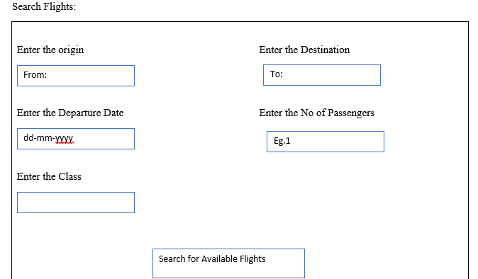

Slide 52
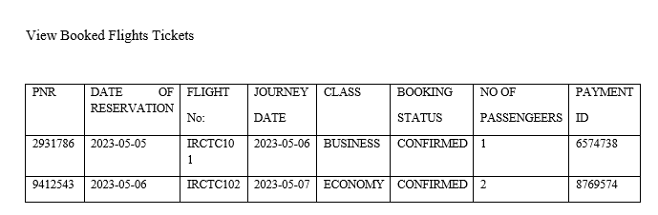

Slide 53
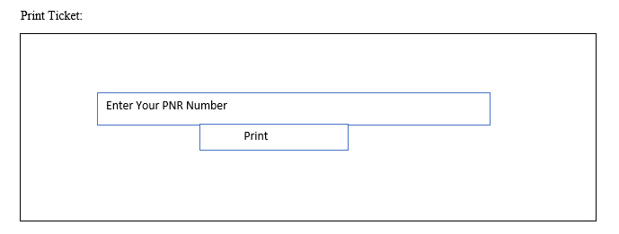

Slide 54
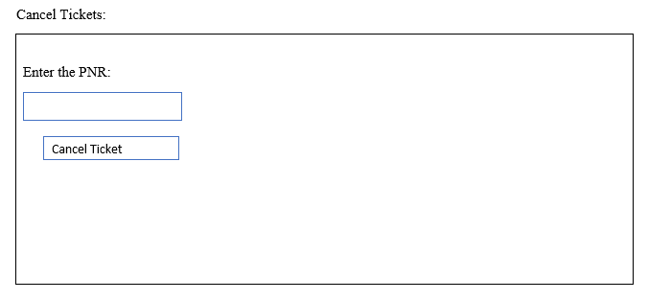

Slide 55
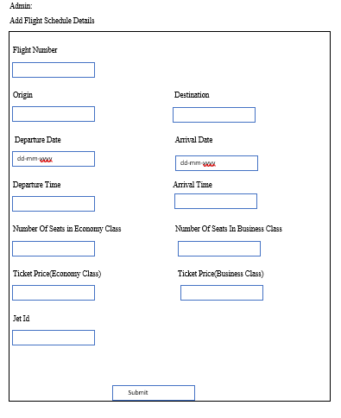

Slide 56
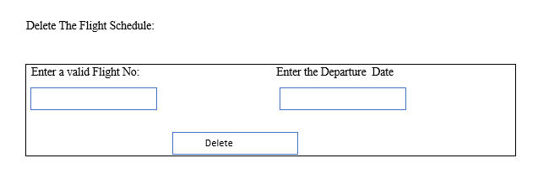

Slide 57
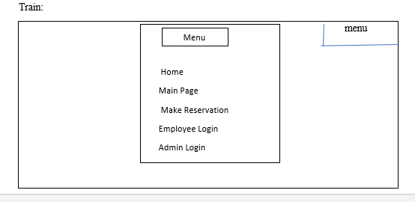

Slide 58
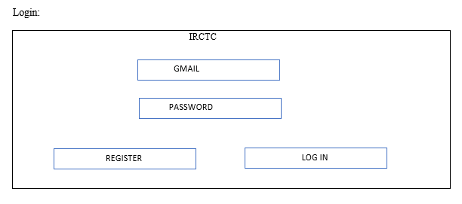

Slide 59
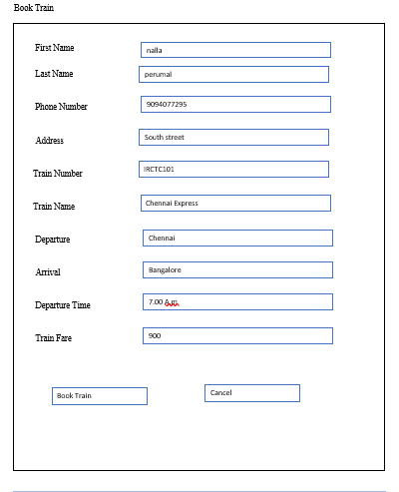

Slide 60
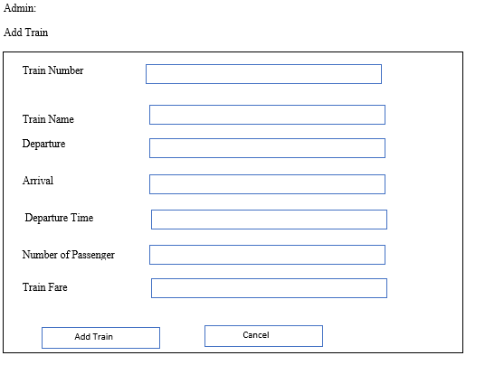

Slide 61


Slide 62


Slide 63


Slide 64
NORMALIZATION
Normalization is the process of organizing the data in the database. Normalization is used to minimize the redundancy from a relation or set of relations. It is also used to eliminate undesirable characteristics like Insertion, Update, and Deletion Anomalies. Normalization divides the larger table into the smaller table and links them using a relationship. The normal form is used to reduce redundancy from the database table.
First Normal Form (1NF)
For a table to be in the First Normal Form, it should follow the following 4 rules:
It should only have single(atomic) valued attributes/columns
Values stored in a column should be of the same domain
All the columns in a table should have unique names
And the order in which data is stored does not matter

Slide 65
Second Normal Form (2NF)
For a table to be in the Second Normal Form,
It should be in the First Normal form
And, it should not have Partial Dependency. Partial Dependency occurs when a non-prime attribute is functionally dependent on part of a candidate key
Third Normal Form (3NF)
A table is said to be in the Third Normal Form when,
It is in the Second Normal form.
And, it doesn't have Transitive Dependency

Slide 66


Slide 67


Slide 68


Slide 69


Slide 70


Slide 71


Slide 72

Flight Home Page

Slide 73


Slide 74


Slide 75

User Page

Slide 76


Slide 77


Slide 78


Slide 79


Slide 80


Slide 81


Slide 82


Slide 83


Slide 84


Slide 85


Slide 86


Slide 87


Slide 88


Slide 89


Slide 90


Slide 91


Slide 92


Slide 93


Slide 94


Slide 95


Slide 96


Slide 97


Slide 98


Slide 99


Slide 100


Slide 101


Slide 102


Slide 103


Slide 104


Slide 105


Slide 106


Slide 107


Slide 108


Slide 109


Slide 110


Slide 111


Slide 112


Slide 113


Slide 114


Slide 115


Slide 116


Slide 117


Slide 118


Slide 119


Slide 120


Slide 121


